Slide 1

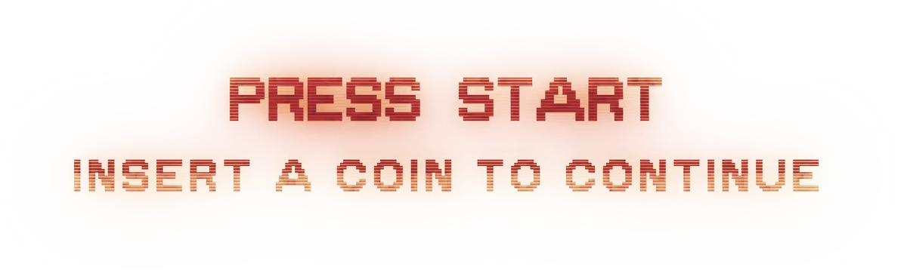
“Hitchhiker” systems
Duncan Jones
💬 @Merrion
Distributed computing for pennies
Notes:
Good afternoon and thank you very much for lending me your time.
My name is Duncan Jones and my twitter handle (probably the easiest way to contract me) is @Merrion
My thesis is something I am calling “Hitchhiker” systems which is to say systems optimised towards lowering cost

Slide 2
Agenda
Sources of cost
Introduction to “event sourcing”
Example code
Introduction to Azure Event Grid
Overview of an example system architecture
Example code
Lessons learned
Q & A
Notes:
First I need to discuss where cost comes from, in the context of cloud computing.
Then a very high level overview of event sourcing because the solution I have put together makes extensive use of this (and I will explain why at the same time).
I will also show some code to illuminate how I am doing this
Then the environment in which this is to be hosted – using the Azure Event Grid, Durable Serverless functions and Azure storage.
Then I will walk through an example of the way the architecture hangs together
Finally I’ll wrap up with lessons learned and Q&A – hopefully questions form you, probably questions from me and maybe even questions from the crocodile.

Slide 3


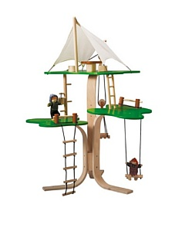
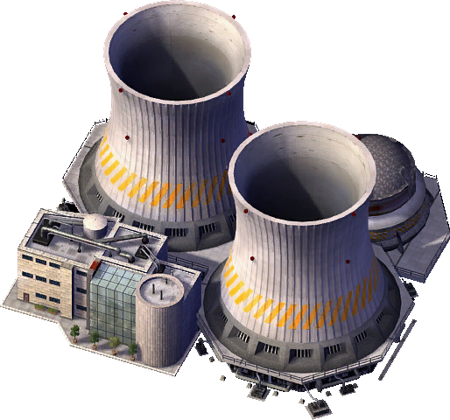
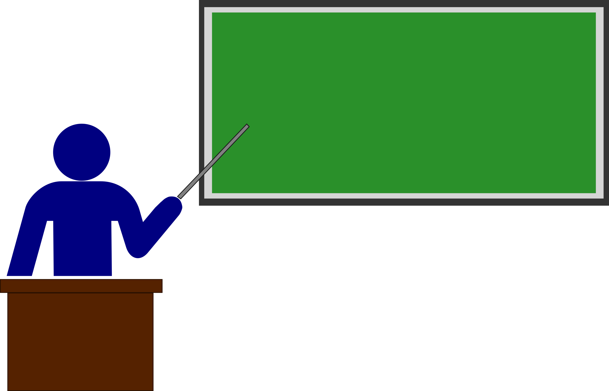

Caveats
Notes:
The system I am describing here is best suited to non critical or occasional/burst use scenarios rather than enterprise critical systems and is tuned toward minimising cost rather than maximised performance. If you are having talks with venture capital firms or describing yourself as “the uber of blah” then this may not be ideally suited for you.
Also, what I am describing is more of an experiment rather than a definitive textbook example.
To manage expectations, what I am looking for is an equivalent to what Blogs did for micropublishing in applications.

Slide 4
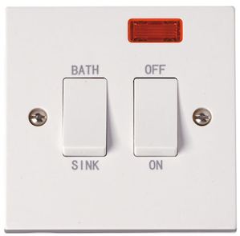
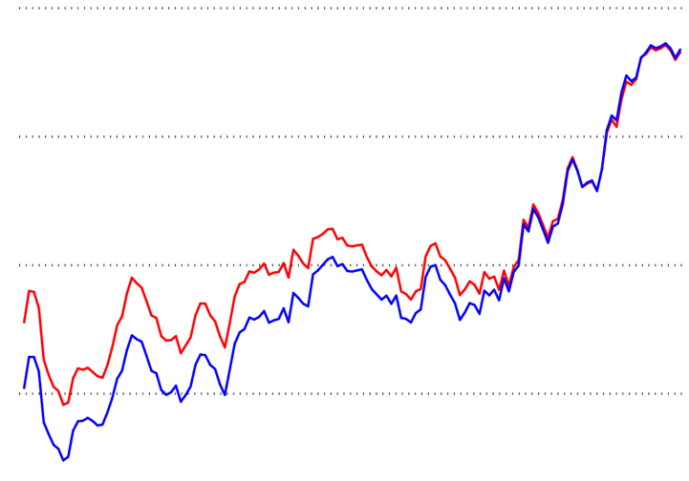
Sources of cost
Fixed costs
Overprovisioning
Notes:
There are two main sources of cost that we need to address with regard to cloud hosted systems:
The first is always-on systems, for example virtual machines, for which a cost arises regardless of use.
The second is overprovisioning, where we have to reserve more processing power than we are using so that we are able to ramp-up to match rapidly increasing demand.
Azure serverless functions address these two sources of cost “out of the box”

Slide 5

Introduction to “event sourcing”
Opened
Account
Deposited Money
Withdrew Money
Closed Account
Margaret
00002
$10.00
$10.00
Event Type | Action
Opened Account | Skip
Deposited Money | Increase balance by $
Withdrew Money | Decrease balance by $
Notes:
Event sourcing is a way of storing data, not as the current state of the entity (as in active state) but rather as a sequential history of all the events that have occurred to an entity.
This history is implemented as an append only event stream. It places the onus on getting “state” onto the system that is reading the data which has to run a projection over the event stream.
This is done by (and is the responsibility of) the process that needs that state, either to report it or to use it in a business decision.
This allows us to eliminate one of the “always on” fixed costs – the state consistency management system (or database to use the more common term).

Slide 6
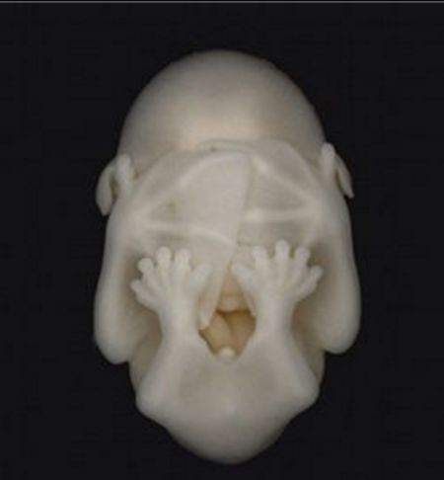
Event sourcing on Azure functions code example
Notes:
So let me show you what the code looks like in practice
(Don’t worry – I’m not going to “live code” it. Even the people who pay me to code don’t actually enjoy watching it happen)

Slide 7



Open a new account
Each account number must be unique
Initial deposit amount (optional)
Beneficiary name (optional)
Notes:
We will start with opening a new account.
The rules are :-
An account can only be created once - therefore if an event stream already exists for the account, do not create a new one or append an account opened event.

Slide 8

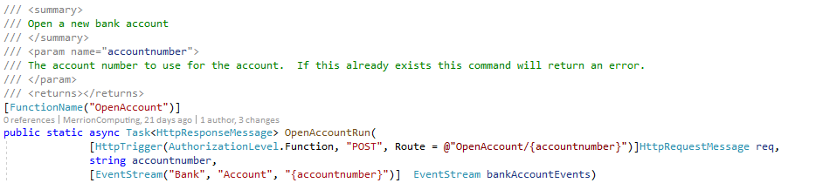
Open a new account
https://retailbankazurefunctionapp.azurewebsites.net/api/OpenAccount/A001B123456C
DOMAIN
ENTITY TYPE
INSTANCE
Notes:
When the serverless function is triggered the account number is taken from the URL and is used to instantiate a new eventstream variable for that bank account.
Each event stream is uniquely identified by a combination of the domain, entity type and unique identifier of that entity.

Slide 9
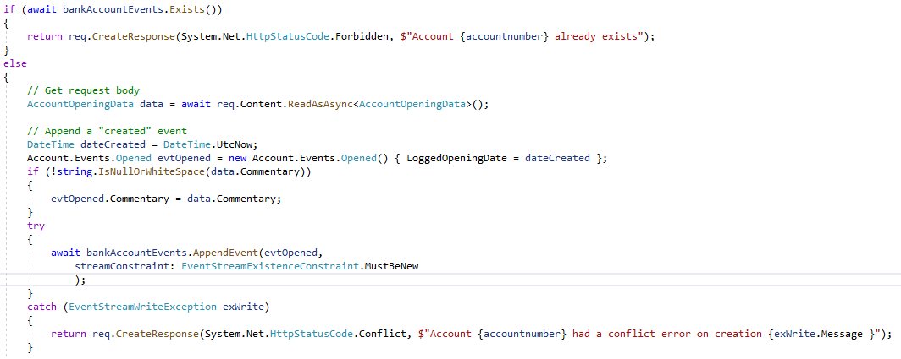
Open a new account
Notes:
1) To enforce the constraint that an account must be new we can first check the event stream does not exist, but also we can pass in a constraint that when writing the first event the event stream must be new.

Slide 10
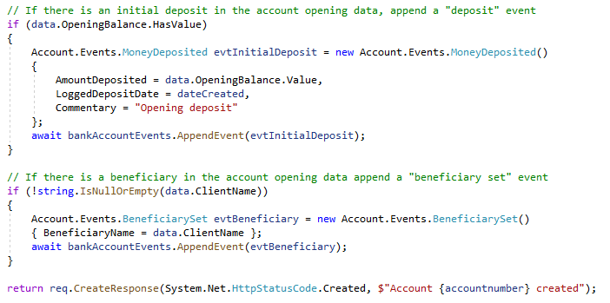
Open a new account
Notes:
In addition, the same function is able to append more than one event onto the event stream if that makes business sense
Here I am adding a deposit event if the account is opened with an initial deposit and a beneficiary set event if the beneficiary name is provided to the open new account function

Slide 11

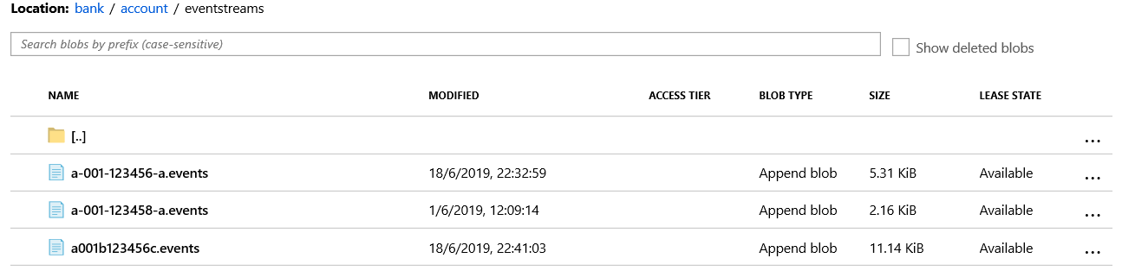
Open a new account
Notes:
The event stream created is stored in the Azure blob storage under a path made of Domain name -> Entity Type

Slide 12
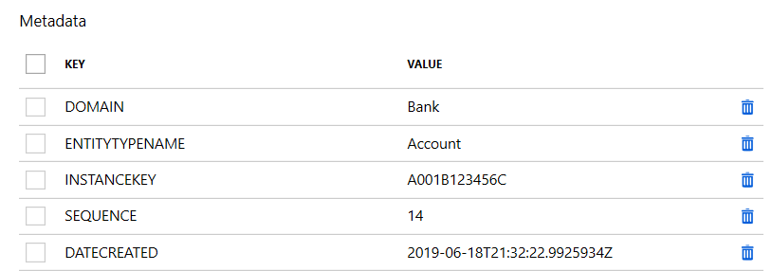
Open a new account
Notes:
Each blob also has metadata set for the properties of the event stream

Slide 13
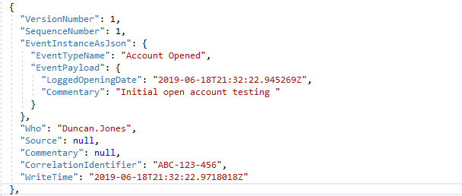
Open a new account
Notes:
The data for each event are in JSON and wrapped in the event context
(Projections only access the data inside the event instance but the outer wrapper is useful for debugging etc)

Slide 14
Make a deposit
Target account for the deposit must exist
Deposit amount
Source of the deposit (optional)
Notes:
Next we need to make a deposit.
Depositing money is the simplest of all operations - we simply need to be sure that the account exists.

Slide 15
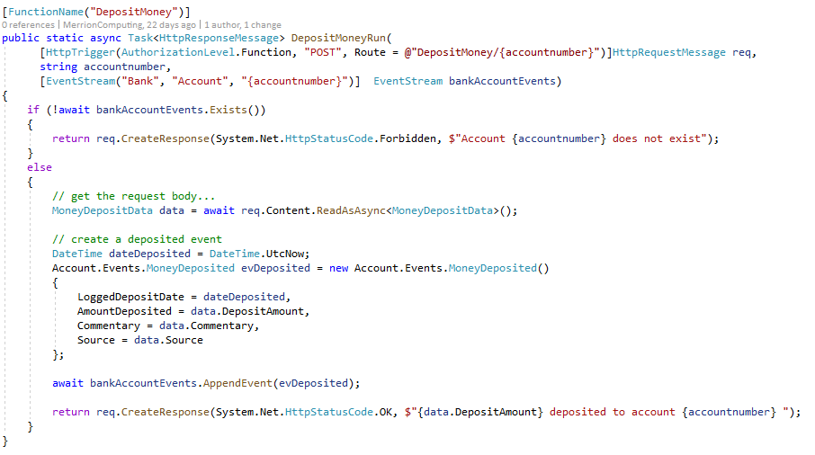
Make a deposit
Notes:
Making a deposit is the simplest function – we simply populate a money deposited event and append it to the event stream for the given bank account.
We check the bank account exists first in case the user has incorrectly entered their account number

Slide 16
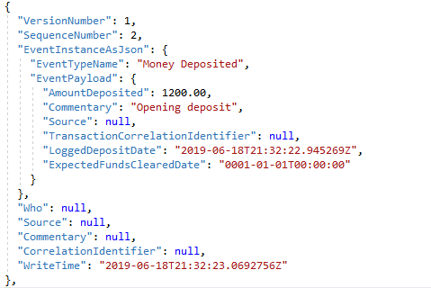
Make a deposit
Notes:
The deposit event is appended to the stream.
Importantly the state (current balance etc.) of the bank account is not stored in the event

Slide 17
Get the balance
The account number to get the balance from must exist
As of date (optional)
Notes:
Getting the balance our of the event stream
To get the balance of the account we need to run a projection over the bank account event stream which handles the money deposited event and the money withdrawn event to give the balance as at a given point.

Slide 18
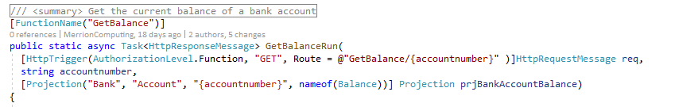
Get the balance
TYPE OF PROJECTION TO RUN
Notes:
To run a projection we need to specify the domain, entity type and instance identity of the event stream we are going to run the projection over, and also we need to specify the class of the projection to run.

Slide 19
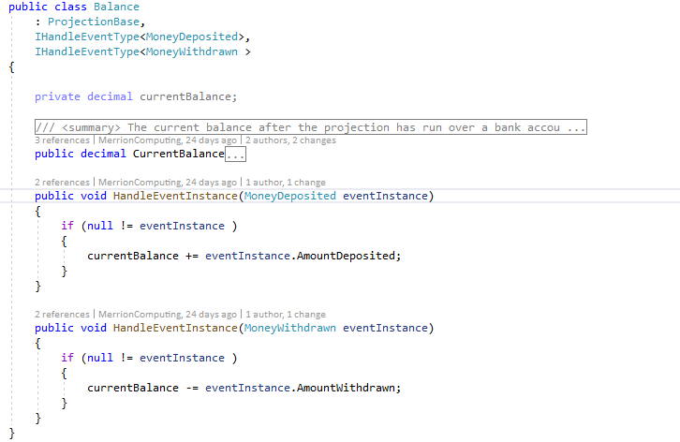
Balance projection
Notes:
The projection is a very simple piece of code that says what events it will handle (by implementing the IHandleEventType interface) and then has a method to be called each time an instance of that event type is encountered in the event stream.
In this case a money deposited event increases the account balance and a money withdrawn event decreases it.

Slide 20
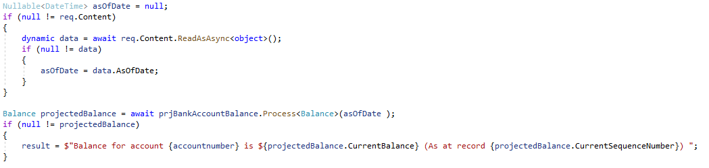
Get the balance
SEQUENCE NUMBER OF LAST EVENT PROCESSED
Notes:
The projection is run and when it has processed all the events in the event stream the value is returned.
1) Every projection also has a Current Sequence Number property that tells you the number of the last event in the stream that it read

Slide 21
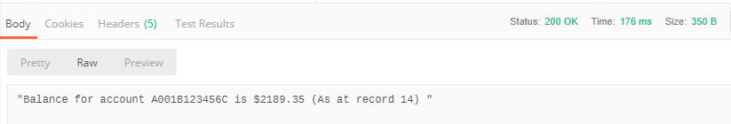
Get the balance
Notes:
Resulting event stream

Slide 22

Make a withdrawal
Target account number for the withdrawal must exist
Balance must be greater than or equal to the withdrawal amount
Concurrency crocodile!
Withdrawal amount
Notes:
Next making a withdrawal
Withdrawing money requires running the balance projection to make sure that the account has the funds available to withdraw and only if it does, post the withdrawal event.
We need to make sure no events have happened between us getting the balance and applying the withdrawal even as if they have we could have a concurrency error.
When posting the withdrawal event we pass in the sequence number returned by the projection and if any other events have been written to the event stream since then an error is thrown and our withdrawal event is not appended.

Slide 23
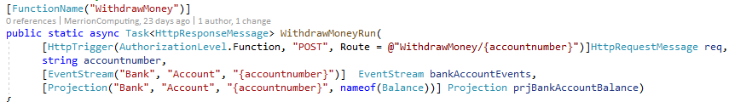
Make a withdrawal
Notes:
The withdrawal function has both an event stream parameter and a projection parameter, both pointing at the same event stream.

Slide 24
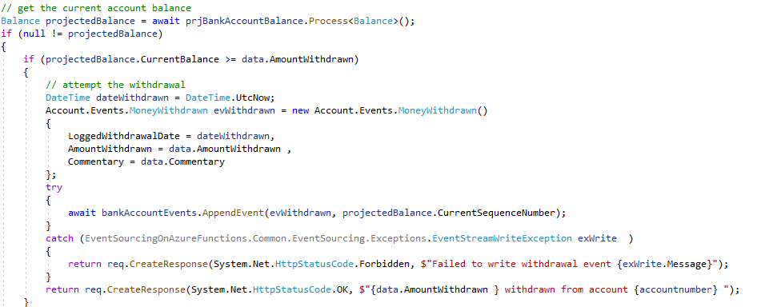
Make a withdrawal
Notes:
By passing in the sequence number we got from the projection we can tell the AppendEvent method to throw an exception if the actual top sequence of the event stream is higher than that when it comes to write the event – this prevents a concurrency error if another thread appends a withdrawal while you are so doing.

Slide 25
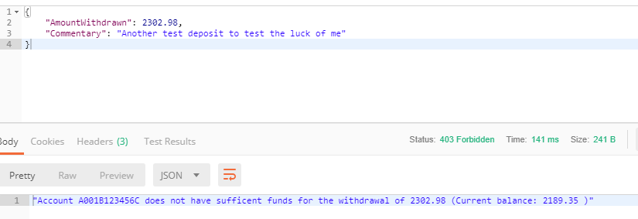
Make a withdrawal
Notes:
The result of this is that we are prevented from withdrawing more money than we have in the account.

Slide 26
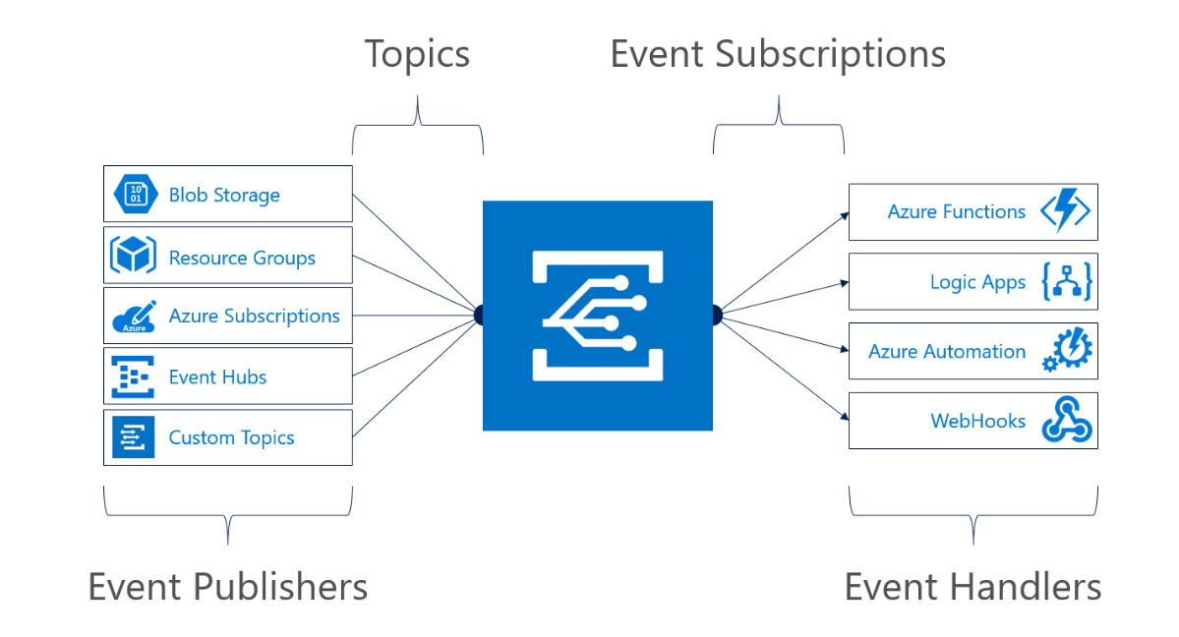
Introduction to Event Grid
At-least once delivery
Always on
Notes:
Event grid is how notifications, commands and queries are passed around my putative system.
Event grid is “always listening” – if it receives a notification it can trigger an invocation (“wake up”) of the azure function(s) subscribing to it.
Event grid will retry sending to a subscription if the send does not succeed – if they fail for 24 hours then the message will be put in a “deal letter” location.
Events will be delivered at least once – but possibly more than once, so you should code defensively for that possibility

Slide 27
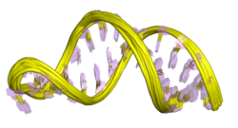
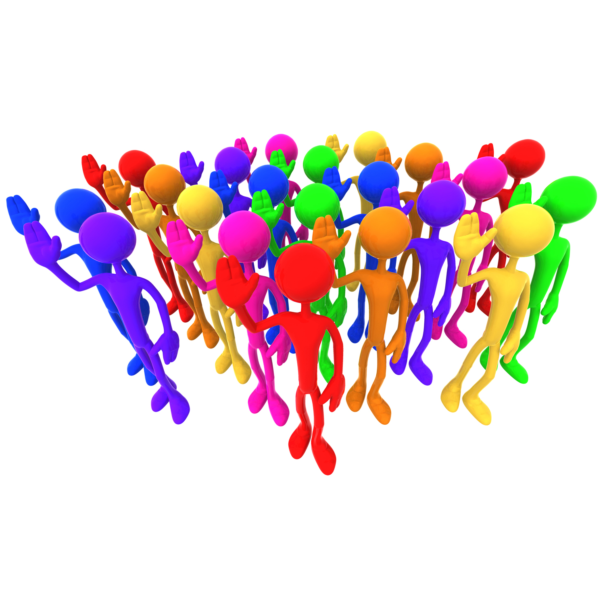


Overview of an example system architecture
League
Race
Query
Command
Runner
Query
Command
Command
Query
Notes:
The demonstration system is for organising an amateur running organisation.
It is split into three domains – the league domain being anything to do with the overall organisation of leagues,
The race domain being to do with an individual race,
The runner domain being relating to the runner and their interaction with the organisation.
Importantly there is no privileged communication between the domains – the interface available to each other is the same interface publicly available outside.

Slide 28
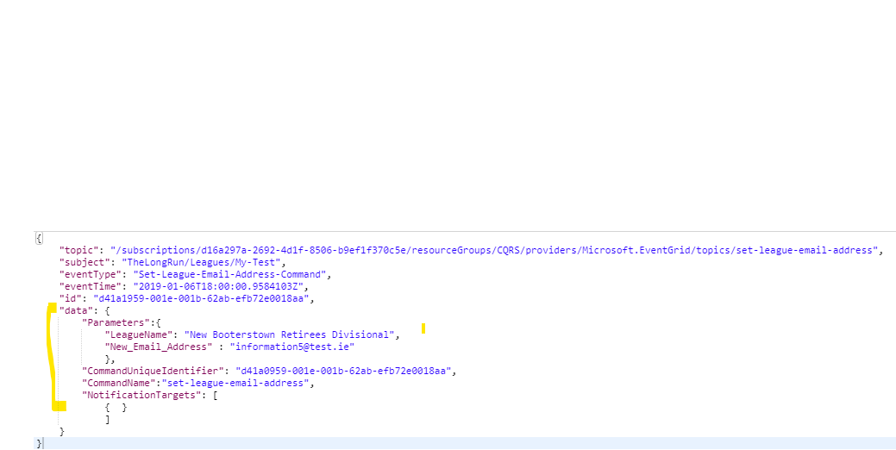


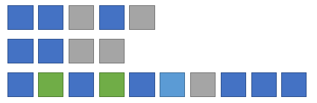
Handling a command
Durable Function Orchestration
Append
Event(s)
Command
Validations
Notes:
A command is issued to the system through an event grid topic.
The parameters required to perform the command as well as any authorisation tokens and externally supplied unique identifier are supplied in the payload to this event grid topic.
When a message is received by the topic it triggers a serverless function to handle the command.
This uses the durable function framework to call activities that perform each step in turn and, if all is OK, appends 1 or more events to the event streams of the entities updated by the command.
As well as the built in durable function orchestration which is backed by a table the command has its own event stream in which the progress is logged.

Slide 29
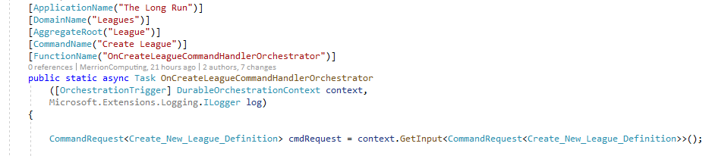
Command orchestrator
Trigger Orchestration
Validate Parameters
Append
Event
Send Notifications
Notes:
The orchestration function has an [OrchestrationTrigger] attribute and durable orchestration through which the details of what kicked off the orchestration can be found

Slide 30
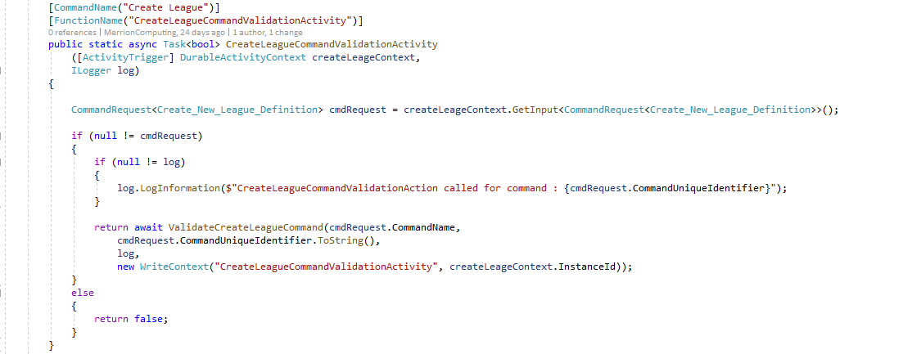
Command orchestrator
Trigger Orchestration
Validate Parameters
Append
Event
Send Notifications
Notes:
The orchestration calls out to Activity methods which do the actual work of each step

Slide 31
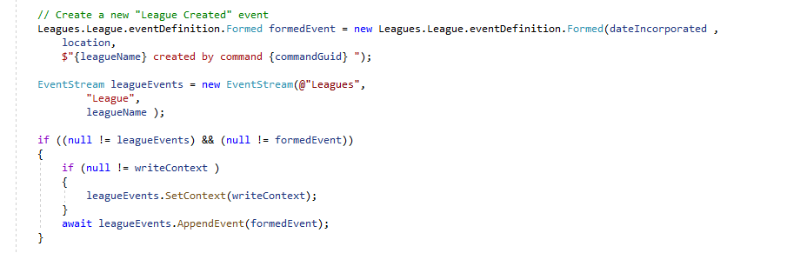
Command orchestrator
Trigger Orchestration
Validate Parameters
Append
Event
Send Notifications
Notes:
Events are appended to the appropriate EventStream in order to record what the command has done – effectively what has changed

Slide 32
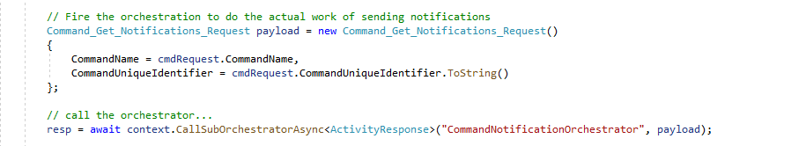
Command orchestrator
Trigger Orchestration
Validate Parameters
Append
Event
Send Notifications
Notes:
An independent sub orchestration is fired off that does all the work to do with notifying other domains of this command’s action

Slide 33
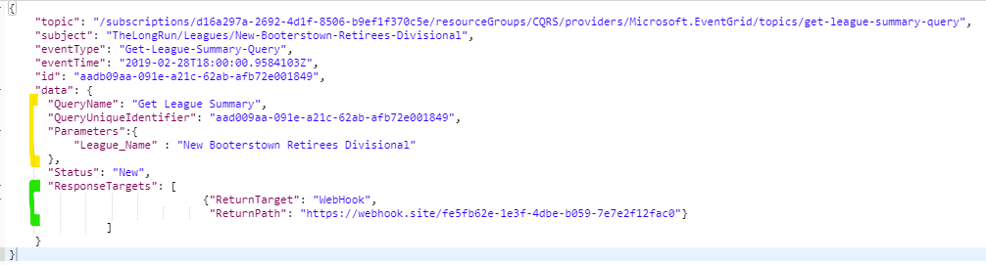
Handling a query
Durable Function Orchestration
Query
Validations
Run
Projection(s)
Return
Results
Notes:
A query is handled in a similar manner but in addition to the parameters you also pass in a return address to which the results of the query should be returned.
This could be, for instance, a webhook or an azure storage location to drop a file into.
This allows the query to be executed asynchronously.
The query runs projections over the event streams of the entities it is getting data for and then performs any aggregation needed over these before returning the results.

Slide 34
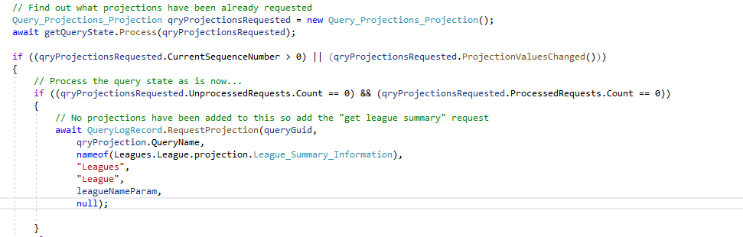
Query orchestrator
Trigger Orchestration
Validate Parameters
Run Projections
Send Results
Request Projections
Notes:
Projection requests are written to the query event stream so we can see what work has been done and what is outstanding in running the query
Projections themselves can then be run in parallel by using durable functions “fan-out” mechanism.
Once all the projections are complete any totting up steps could run.

Slide 35
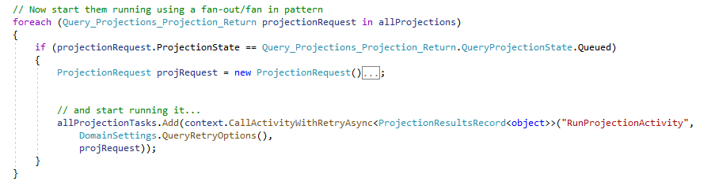
Query orchestrator
Trigger Orchestration
Validate Parameters
Run Projections
Send Results
Request Projections
Notes:
Projection requests are written to the query event stream so we can see what work has been done and what is outstanding in running the query
Projections themselves can then be run in parallel by using durable functions “fan-out” mechanism.
Once all the projections are complete any totting up steps could run.

Slide 36
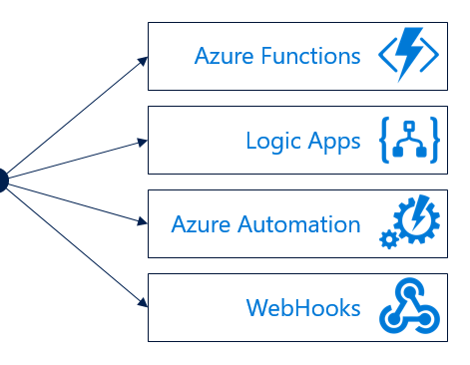
Notifications and inter-domain communication
Notes:
Domains communicate directly with each other by these commands and queries
Domains can also raise notifications that other domains or indeed other processes can subscribe to.
(These notifications are tagged with the “as of date” and “as of sequence number” information so that the subscriber can determine if it has already received this notification before.)

Slide 37
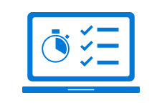
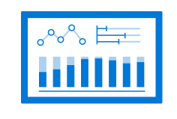
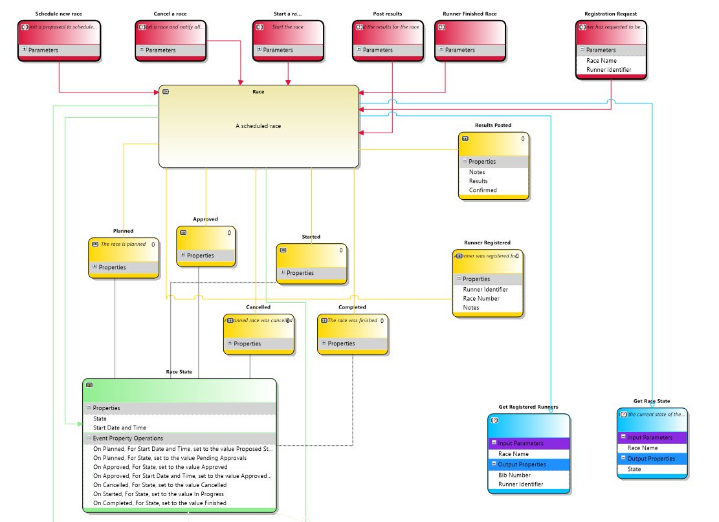
Lessons learned
Don’t assume. Measure!
Read your writes
Invest time in design
Notes:
Because serverless computing is no less susceptible to the “sunk cost fallacy” it is worth investing time in design before getting started coding. It is a mistake to allow the rapid spin-up time of serverless functions as an excuse not to do some design work. I would recommend looking at things like event storming as a way to do this.
If you are dealing with a system that needs to be able to survive being spun down without the worry of data loss requires being rigorous about reading your won writes – i.e. making sure any state change is persisted before it is used.

Slide 38
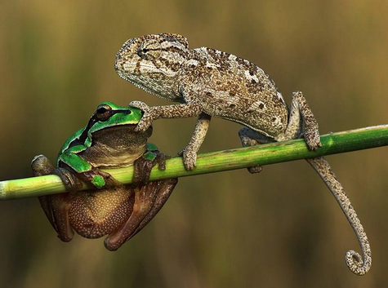
Questions?
@Merrion

Slide 39
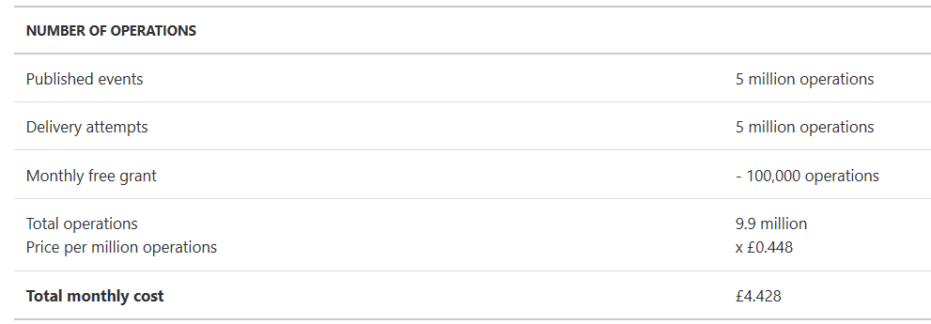
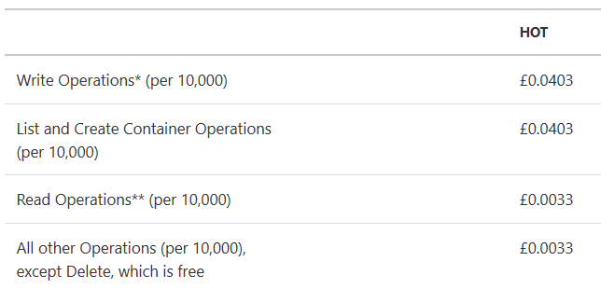
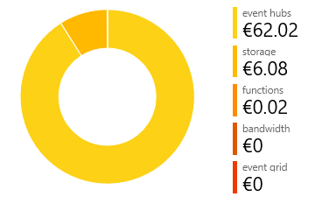
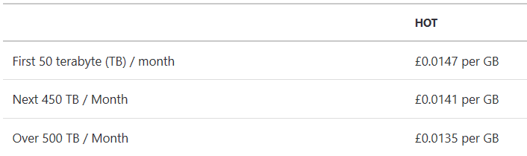
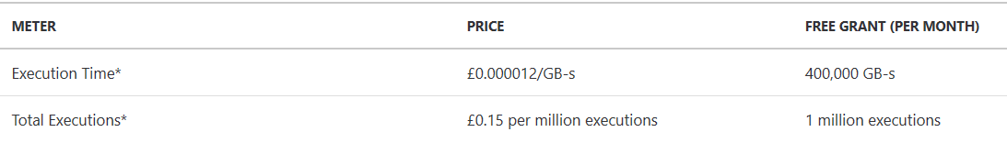
Costs
Event Grid
<£1 / day
<
Blob storage
Azure functions

Slide 40
Code and architecture recap
Event Grid function triggers
Event sourcing with Azure functions
Query orchestration
Command orchestration
Fan-out
Event streams and projections
https://github.com/MerrionComputing/EventsSourcing-on-Azure-Functions
https://github.com/MerrionComputing/AzureFunctions-TheLongRun-Leagues
Notes:
Event Grid for the reliable messaging between domains (and with the outside world) – this allows us to stitch together domains with publish-subscribe, which means we can easily extend the system.
Serverless function hosting for dynamic scaling.
Durable Function Orchestration for the long running processes that handle the commands and queries.
Durable functions fan out/fan in for processes that can run in parallel.
Event sourcing to save on the overhead required by using a database.

